Slide 1
The Context in which HRM takes place
Session 2/10
Part II

Slide 2
Globalization, by sociologists
“Globalization can […] be defined as the intensification of worldwide social relations which link distant localities in such a way that local happenings are shaped by events occurring many miles away and vice versa.”
(Giddens, 1990:64)

Slide 3
Globalization, by sociologists
“The process of globalization suggests simultaneously two images of culture. The first image entails the extension outwards of a particular culture to its limit, the globe. Heterogeneous cultures become incorporated and integrated into a dominant culture which eventually covers the whole world. The second image points to the compression of cultures. Things formerly held apart are now brought into contact and juxtaposition.”
(Featherstone, 1995: 6-7)

Slide 4
Key Ideas
Globalizing values and views of the world
Interdependence between societies
Cultural enrichment?
An irreversible trend?

Slide 5
Globalization, by economists
“Globalization refers to the growing economic interdependence of countries worldwide through the increasing volume and variety of cross-border transactions in goods and services and of international capital flows, and also through the more rapid and widespread diffusion of technology.” (IMF, 1997)

Slide 6
Globalization, by economists
“The inexorable integration of markets, nation-states and technologies to a degree never witnessed before - in a way that is enabling individuals, corporations and nation-states to reach around the world farther, faster, deeper and cheaper than ever before, and in a way that is also producing a powerful backlash from those brutalized or left behind by this new system… Globalization means the spread of free-market capitalism to virtually every country in the world.” (Friedman, 1999: 7-8)

Slide 7
Key Ideas
There is a growing internationalization dynamic
It is dominated by uncontrollable market forces
Its principal economic actors and major agents of change are truly transnational corporations
MNCs owe allegiance to no nation state and locate wherever on the global market advantage dictates.

Slide 8
Globalization & the rise of new economy sectors
Decreasing costs of transport, ICTs, and the reduction of barriers to international trade.
Transfer of parts of the productive process to developing countries.
  However, important sets of economic activity have remained in industrialized countries (e.g. In the case of the US hard disk drive industry, production was mainly offshored, whereas design and research and development activities have remained in the US (McKendrick, Doner & Haggard, 2000))
Premium for skills

Slide 9
Globalization – Caveats
We do not live in a fully globalized world
  Some regions, like North America & Western Europe have generally experienced more globalization than others (e.g. sub-Saharan Africa)
  Large cities (like London) have more global connections than rural areas
  Individuals from specific age groups, social classes, ethnic groups, etc. have more global connections than others

Slide 10
Globalization – Caveats
Globalization is not necessarily inexorably expanding
  Trade volumes in 1914 stood at 40 times their value in 1780 but the two world wars and the Great Depression of the early 1930s markedly reduced international trade.

Slide 11
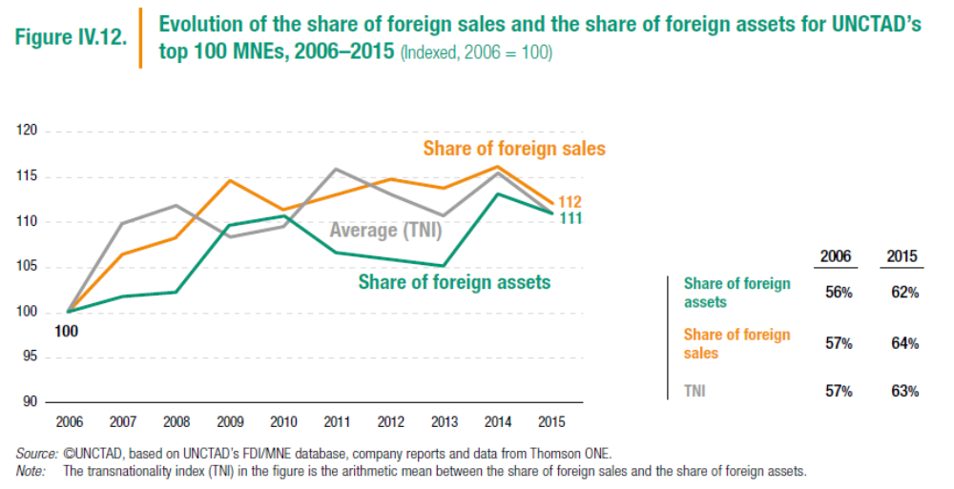
Globalization – Caveats
The share of foreign assets and foreign sales of the top MNE seems to be increasing since 2006 but MNE still remain largely embedded in their home countries
Source: UNCTAD 2017

Slide 12
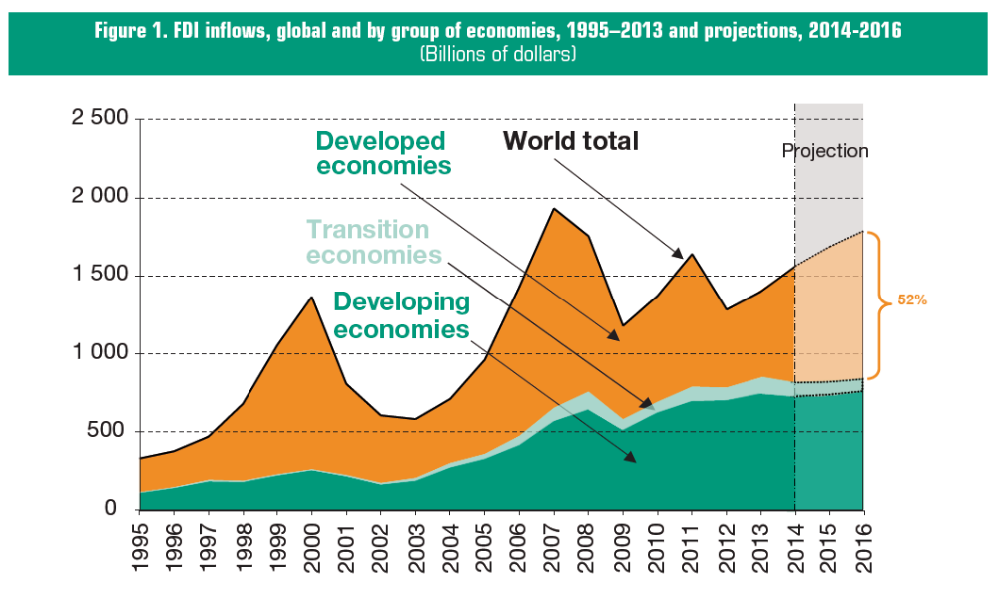
Globalization – Caveats
Trade, investment and financial flows remain heavily concentrated in the so-called triad of Europe, Asia Pacific and North America
  2011-13 54% of FDI flows went to developed economies
  2011-13 Developing Asia continues to be the region with the highest FDI inflows
  2011-13 FDI inflows also increased in Africa (4%), Latin America and the Caribbean (6%)
Source: UNCTAD 2014

Slide 13
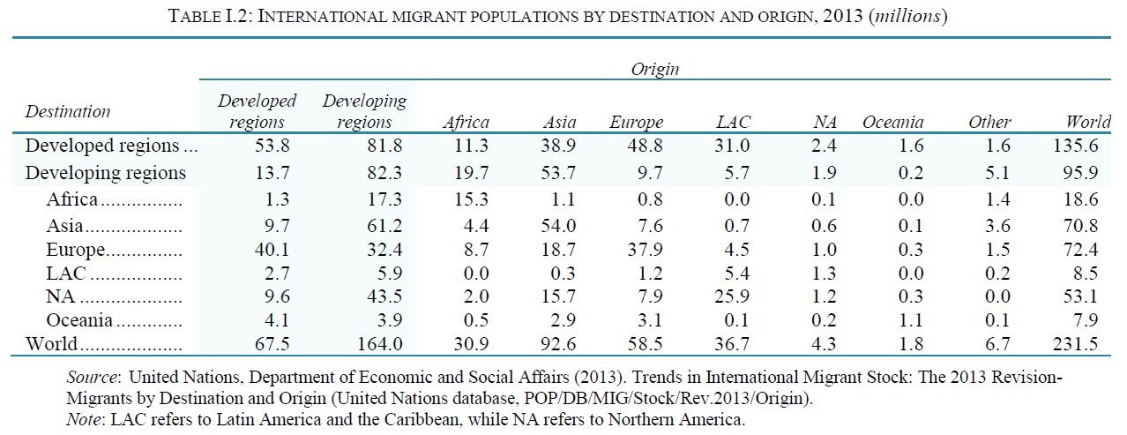
Globalization – Caveats
Some key numbers on migrations
232 Million Migrants in 2013 (less than 4% of the world population)
59% lived in developed regions
41% in developing regions
Source: UN 2014

Slide 14
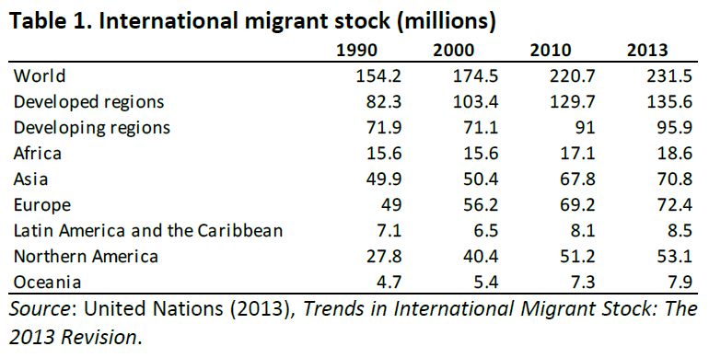
Globalization – Caveats
Between 1990 and 2013 the number of international migrants worldwide rose by 50% [69% in the developed regions]

Slide 15

The Complexity of Globalization

Slide 16
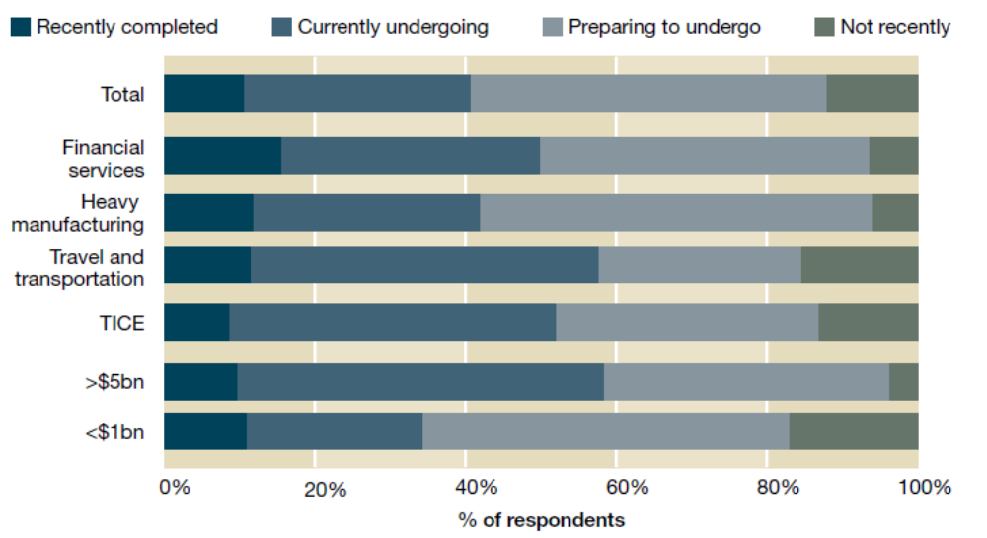
A changing business environment
  The majority of companies participating in the 2021 Global talent study were either preparing or undergoing significant processes of change.

Slide 17
Changing competitive landscapes and changing employment relations
Organizations have responded to the competitive turmoil by:
  Relying on continuous innovation
  knowledge management
  Developing flexible structures
Changing employment relations (increase of atypical forms of employment?)
Changing psychological contracts (from relational to transactional?)
Changing career patterns (the end of career jobs?)

Slide 18
What are the key challenges for HRM?
The demand-supply gap
Changing employment relations and managing the psychological contract
Demographic trends
The “new career”and increasing workforce mobility
Attracting and managing a diverse workforce

